Slide 1
ELIMINATE CHRONIC HEPATITIS B IN WASHINGTON STATE
Nadine Shiroma
HBV Civil Rights Advocate &
Policy Advisor to the Hepatitis B Foundation
Nadine.Shiroma@gmail.com Ph: 425-753-1257

Slide 2
WHY ELIMINATE CHRONIC HEPATITIS B IN WASHINGTON STATE
All 6 Asian Pacific Islander Coalitions of Washington State, the Somali Health Board, Hepatitis Education Program in Seattle and a Policy Advisor to the Hepatitis B Foundation have requested that Governor Inslee amend his September, 2018 Chronic Hepatitis C (HCV) Elimination Directive to include eradication of chronic hepatitis B (HBV). This request is based on the following.
Chronic HBV is not mentioned in the governor’s HCV elimination directive, yet it is an equally serious, silent, asymptomatic liver disease and health disparity in immigrant, foreign-born communities. Though research for a cure continues, an HBV vaccine has been widely available in the U.S. since 1986.
In the U.S. HBV vaccinations are recommended for infants and mandatory for children in most school districts, but worldwide the vaccine is NOT routinely administered to children or infants born to HBV-infected moms. 90% of those infected at birth or as young children go on to develop chronic HBV.

Slide 3
Left undiagnosed or untreated, persons with chronic HBV can infect unvaccinated persons through blood-to-to blood transmission. 25% of the chronically infected will develop liver cancer or cirrhosis.
In 1986 chronic HBV affected both U.S.-born and foreign-born. Though it was not described as such, HBV was already a health disparity for the foreign-born. Since 1986 the HBV burden in the U.S. has shifted to the foreign-born, many of whom remain unscreened, unvaccinated and without linkage to appropriate medical care and treatment.
Our country’s 32 year focus of HBV vaccination for infants, young children and students has protected the younger youth and young adults. Yet 75% of U.S. adults are currently unvaccinated and unprotected from HBV – data evidenced by the growing number of reported HBV cases linked to the current opioid epidemic.

Slide 4
A serious health disparity that primarily impacts minority foreign-born populations can easily become the target of discriminatory institutional policies, especially if such policies and practices go unreported and there are no organizations to defend, push back or speak out against the institutional discrimination. The LGBTQ community has done this since the 1980’s for people diagnosed with HIV.
It is incumbent on us as advocates for a community that is disparately impacted by the disease to protect the disability and civil rights of those impacted and to advocate for public health policies, research and funding to prevent further HBV transmission and the suffering, economic costs – including costs for treatment, hospitalization or liver transplants -- stigma and discrimination that accompany this chronic disease.
Expansion of the Governor’s Hepatitis C Elimination Directive to include eradication of hepatitis B is in the public health interest and will bring Washington in line with recommendations of both the World Health Organization and the National Academies of Science, Engineering and Medicine, which have called for elimination of hepatitis B and hepatitis C by 2030.

Slide 5
PERSONAL STORIES AND HBV EDUCATION AND ADVOCACY RESOURCES
Watch and listen to the personal stories (2.5 to 3 minutes each) of individuals or family members impacted by chronic HBV, including Randy from Western Washington. These stories are part of the "Just B" Program produced through a collaboration of the Hepatitis B Foundation and the StoryCenter. Also included: a link to the program discussion guide, which includes each story transcript and a photo, content summary, key take-away points, and discussion questions and answers. HBV information and resource links are likewise included in the discussion guide.
Alan's story: www.hepb.org/research-and-programs/patient-story-telling-project/alans-story/
Bunmi's story: www.hepb.org/research-and-programs/patient-story-telling-project/bunmis-story/
Randy's story: www.hepb.org/research-and-programs/patient-story-telling-project/randys-story/
"Just B" discussion guide: www.hepb.org/assets/Uploads/JustBDiscussionGuide-2018-12-2.pdf (see pgs 57 & 58 for links to HBV fact sheets and resources for HBV education and advocacy.
[For questions or to request a digital copy with links,
contact nadine.shiroma@gmail.com or phone 425-753-1257.]

Slide 6
Discovery of Hepatitis B Virus
and Development of HBV Vaccine
1969
- Hep B
Virus
discovered
2002 – DOD
mandates HBV
immunization for
all incoming
service members
1981 –
1st commercial
HBV vaccine
approved
2018 - 2-dose
HBV vaccine
approved
1976 –
HBV
vaccine
developed
1986 –
2nd commercial
HBV vaccine
approved

Slide 7
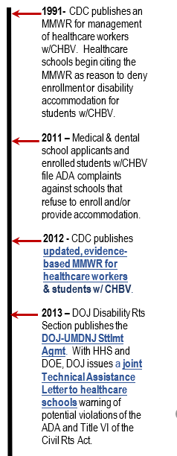
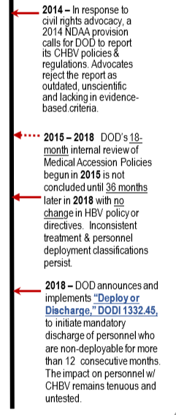
Advocacy Against
HBV Institutional Discrimination

Slide 8
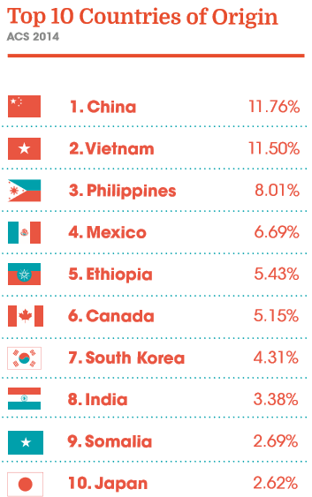
In 2000, 15.4% of King County residents were born in another country.
By 2017, this %age had grown to 23.6%. Between 2000 and 2017, King County's total population increased by around 451,000 residents.
Seattle

Slide 9
Origins of foreign-born residents differ between King County and the United States. Greater than half of the foreign-born residents of King County hail from Asia and one-fifth from the Americas, while for the United States as a whole, 52.2% of foreign-born residents are from the Americas and 31% from Asia. In King County, the most common countries of origin are Taiwan and China, including Hong Kong, (71,342), India (62,021), and Mexico (57,840 residents).

Slide 10
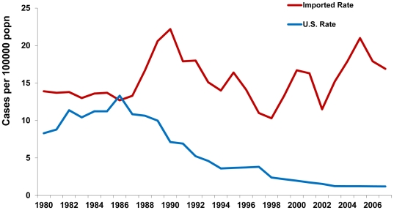
Increasing Burden of Imported Chronic Hepatitis B in the U.S., 1974–2008
(www.ncbi.nlm.nih.gov/pmc/articles/PMC3233539)
The estimated incidence of new, domestically acquired cases of chronic hepatitis B declined from approximately 10 cases per100,000 population in 1991 to the current rate of 1.2 cases per 100,000 (CDC, unpublished data).
Today over 80% of the world's population lives in countries of intermediate (2%–7%) or high (≥8%) prevalence.
In the past 35 years the burden of chronic HBV infection -- which was already a health disparity in foreign born immigrant communities -- has shifted from the U.S.- born to the foreign-born. The national strategy for elimination of domestic transmission of HBV through immunization must take into account the burden of disease among foreign-born Americans.
Incidence of Chronic Hepatitis B, U.S.-Acquired vs. Estimated Imported, United States, 1980–2008.

Slide 11
HBV vaccination is recommended for all infants and mandatory for most school-age children.
The HBV vaccine is recommended for adults who are at risk for hepatitis B virus infection, including:
People whose sex partners have hepatitis B
Sexually active persons who are not in a long-term monogamous relationship
Persons seeking evaluation or treatment for a sexually transmitted disease
Men who have sexual contact with other men
People who share needles, syringes, or other drug injection equipment
People who have household contact with someone infected with the hepatitis B virus
Health care and public safety workers at risk for exposure to blood or body fluids
Residents and staff of facilities for developmentally disabled persons
Persons in correctional facilities
Victims of sexual assault or abuse
Travelers to regions with increased rates of hepatitis B
People with chronic liver disease, kidney disease, HIV infection, or diabetes
Anyone who wants to be protected from hepatitis B

Slide 12
For HBV Vaccine Information and translations in the following languages, go to www.immunize.org/vis/vis_hepatitis_b.asp NOTE: You are encouraged to distribute the up-to-date English-language Vaccine Information Statement at the same time as the translation.

Slide 13
COMPARE THE HBV & HCV GEOGRAPHIC DISTRIBUTION IN KING COUNTY
HEPATITIS B
King County annual
Average Acute & Chronic
HBV Case Rates
HEPATITIS C
King County annual
Average Acute & Chronic
HBV Case Rates

Slide 14
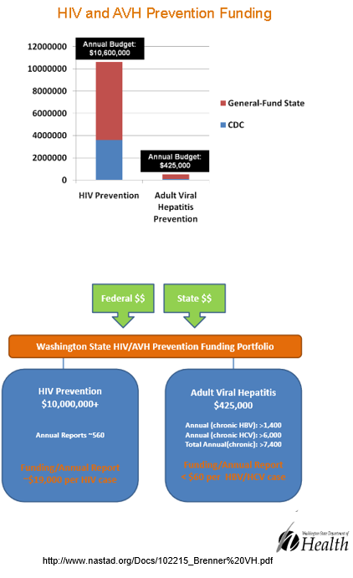
SOURCE: NASTAD, a leading non-partisan non-profit association that represents public health officials who administer HIV and hepatitis programs in the U.S. and around the world.

Slide 15
BASIC FACTS & DATA HBV and HCV in WA Dec 2000 through Dec 2011

Slide 16
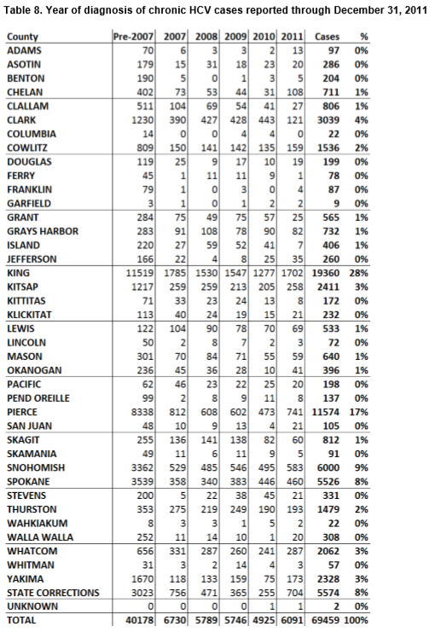
COMPARE CRITICAL FACTS, DATA AND FUNDING FOR PREVENTION OF CHRONIC HBV VS CHRONIC HCV
Source: Washington State Chronic Hepatitis B and Chronic Hepatitis C Surveillance Report
Summary of Cases Reported December 2000 through December 2011
https://www.doh.wa.gov/Portals/1/Documents/Pubs/150-028-ChronicHepatitisBandCSurveillanceReport.pdf

Slide 17
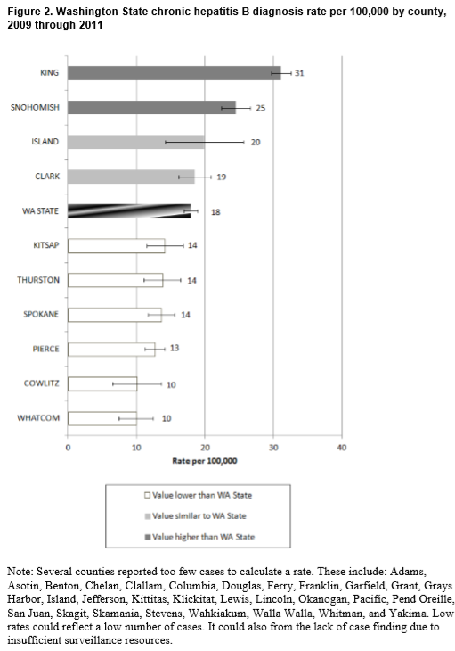
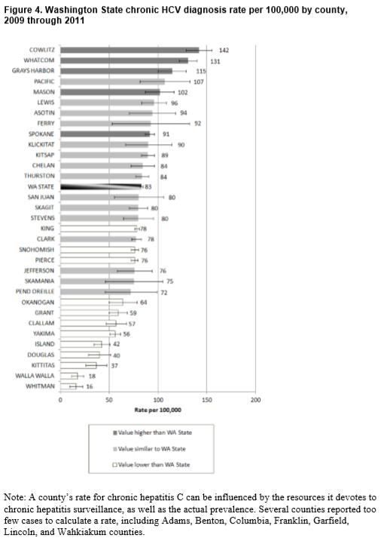
KING COUNTY
WA STATE
WA STATE
KING COUNTY

Slide 18
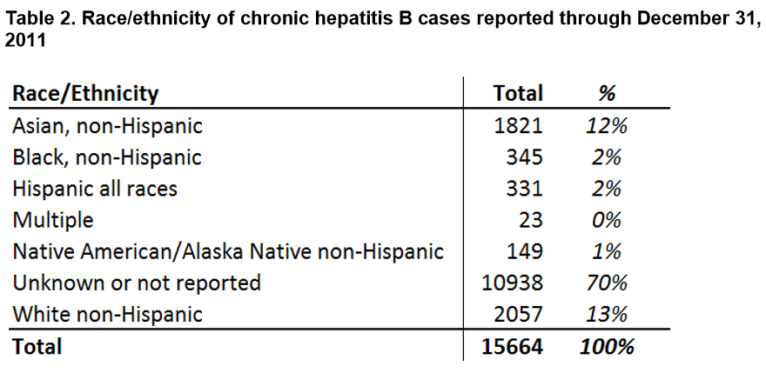
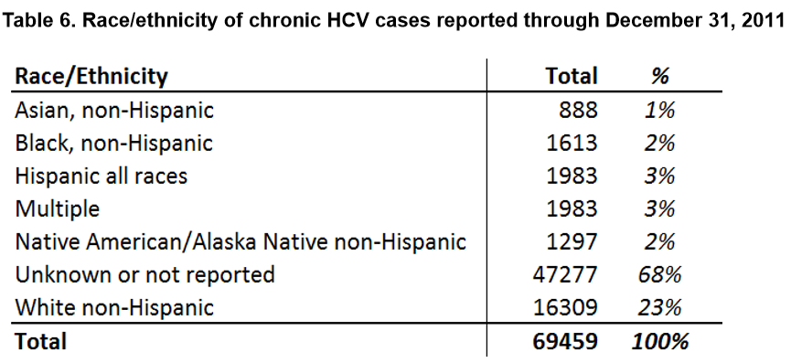

Slide 19
How is hepatitis B spread?
Transmission occurs when blood, semen, or other body fluid infected with the hepatitis B virus enters the body of a person who is not infected. Adults in the United States most commonly spread HBV through sexual contact, which accounts for nearly two-thirds of acute hepatitis B cases. People can become infected with the virus during activities such as:
• Birth (spread from an infected mother to her baby during birth)
• Sex with an infected partner
• Sharing needles, syringes, or other drug-injection equipment
• Sharing items such as razors or toothbrushes with an infected person
• Direct contact with the blood or open sores of an infected person
• Exposure to blood from needlesticks or other sharp instruments
The virus does not spread routinely through food or water. However, there have been instances in which people have transmitted HBV to babies when they gave them pre-chewed food. People do not spread HBV by sharing eating utensils, breastfeeding, hugging, kissing, holding hands, coughing, or sneezing.
How is hepatitis C spread?
The virus spreads when blood from a person infected with the hepatitis C virus enters the body of someone who is not infected. Today, most people become infected with the hepatitis C virus when they share needles or other equipment to inject drugs. In 1992, the U.S. began to screen its blood supply for HCV. Before then, people got HCV when they received infected blood or organ transplants.
People can spread HCV within a household, but this does not occur very often. If it does happen, it is most likely a result of direct, through-the-skin exposure to the blood of an infected household member.
Pregnant women rarely pass HCV to their babies. About 4 of every 100 infants born to mothers with hepatitis C become infected with the virus. However, the risk is higher if the mother has both HIV infection and hepatitis C. People do not spread HCV by sharing eating utensils, breastfeeding, hugging, kissing, holding hands, coughing, or sneezing. It is also not spread through food or water.

Slide 20
Hepatitis B - Key Facts (http://www.who.int/news-room/fact-sheets/detail/hepatitis-b)
Hepatitis B is a viral infection that attacks the liver and can cause both acute and chronic disease.
The virus is transmitted through contact with the blood or other body fluids of an infected person.
An estimated 257 million people are living with hepatitis B virus infection (defined as hepatitis B surface antigen positive).
NOTE: Globally, 36.9 mill people live with HIV.
In 2015, hepatitis B resulted in 887 000 deaths, mostly from complications (including cirrhosis and hepatocellular carcinoma).
Hepatitis B is an important occupational hazard for health workers.
However, it can be prevented by currently available safe and effective vaccine.
Hepatitis B is a potentially life-threatening liver infection caused by the hepatitis B virus (HBV). It is a major global health problem. It can cause chronic infection and puts people at high risk of death from cirrhosis and liver cancer.
A vaccine against hepatitis B has been available since 1982. The vaccine is 95% effective in preventing infection and the development of chronic disease and liver cancer due to hepatitis B.
Geographical distribution
Hepatitis B prevalence is highest in the WHO Western Pacific Region and the WHO African Region, where 6.2% and 6.1% respectively of the adult population is infected. In the WHO Eastern Mediterranean Region, the WHO South-East Asia Region and the WHO European Region, an estimated 3.3%, 2.0% and 1.6%% of the general population is infected, respectively. 0.7% of the population of the WHO Region of the Americas is infected.
Transmission
The hepatitis B virus can survive outside the body for at least 7 days. During this time, the virus can still cause infection if it enters the body of a person who is not protected by the vaccine. The incubation period of the hepatitis B virus is 75 days on average, but can vary from 30 to 180 days. The virus may be detected within 30 to 60 days after infection and can persist and develop into chronic hepatitis B.
In highly endemic areas, hepatitis B is most commonly spread from mother to child at birth (perinatal transmission), or through horizontal transmission (exposure to infected blood), especially from an infected child to an uninfected child during the first 5 years of life. The development of chronic infection is very common in infants infected from their mothers or before the age of 5 years.
Hepatitis B is also spread by percutaneous or mucosal exposure to infected blood and various body fluids, as well as through saliva, menstrual, vaginal, and seminal fluids. Sexual transmission of hepatitis B may occur, particularly in unvaccinated men who have sex with men and heterosexual persons with multiple sex partners or contact with sex workers. Infection in adulthood leads to chronic hepatitis in less than 5% of cases. Transmission of the virus may also occur through the reuse of needles and syringes either in health-care settings or among persons who inject drugs. In addition, infection can occur during medical, surgical and dental procedures, through tattooing, or through the use of razors and similar objects that are contaminated with infected blood.
Symptoms
Most people do not experience any symptoms during the acute infection phase. However, some people have acute illness with symptoms that last several weeks, including yellowing of the skin and eyes (jaundice), dark urine, extreme fatigue, nausea, vomiting and abdominal pain. A small subset of persons with acute hepatitis can develop acute liver failure, which can lead to death.
In some people, the hepatitis B virus can also cause a chronic liver infection that can later develop into cirrhosis (a scarring of the liver) or liver cancer.
Who is at risk for chronic disease?
The likelihood that infection becomes chronic depends upon the age at which a person becomes infected. Children less than 6 years of age who become infected with the hepatitis B virus are the most likely to develop chronic infections.
In infants and children:
80–90% of infants infected during the first year of life develop chronic infections; and
30–50% of children infected before the age of 6 years develop chronic infections.
In adults:
less than 5% of otherwise healthy persons who are infected as adults will develop chronic infection; and
20–30% of adults who are chronically infected will develop cirrhosis and/or liver cancer.

Slide 21
Hepatitis C - Key facts (http://www.who.int/news-room/fact-sheets/detail/hepatitis-c)
Hepatitis C is a liver disease caused by the hepatitis C virus: the virus can cause both acute and chronic hepatitis, ranging in severity from a mild illness lasting a few weeks to a serious, lifelong illness.
The hepatitis C virus is a bloodborne virus and the most common modes of infection are through exposure to small quantities of blood. This may happen through injection drug use, unsafe injection practices, unsafe health care, and the transfusion of unscreened blood and blood products.
Globally, an estimated 71 million people have chronic hepatitis C infection. NOTE: Globally, 36.9 mill people live with HIV.
A significant number of those who are chronically infected will develop cirrhosis or liver cancer.
Approximately 399 000 people die each year from hepatitis C, mostly from cirrhosis and hepatocellular carcinoma.
Antiviral medicines can cure more than 95% of persons with hepatitis C infection, thereby reducing the risk of death from liver cancer and cirrhosis, but access to diagnosis and treatment is low.
There is currently no vaccine for hepatitis C; however research in this area is ongoing.
Hepatitis C virus (HCV) causes both acute and chronic infection. Acute HCV infection is usually asymptomatic, and is only very rarely (if ever) associated with life-threatening disease. About 15–45% of infected persons spontaneously clear the virus within 6 months of infection without any treatment.
The remaining 60–80% of persons will develop chronic HCV infection. Of those with chronic HCV infection, the risk of cirrhosis of the liver is between 15–30% within 20 years.
Geographical distribution Hepatitis C is found worldwide. The most affected regions are WHO Eastern Mediterranean and European Regions, with the prevalence of 2.3% and 1.5% respectively. Prevalence of HCV infection in other WHO regions varies from 0.5% to 1.0%. Depending on the country, hepatitis C virus infection can be concentrated in certain populations (for example, among people who inject drugs) and/or in general populations. There are multiple strains (or genotypes) of the HCV virus and their distribution varies by region.
Transmission The hepatitis C virus is a bloodborne virus. It is most commonly transmitted through:
injecting drug use through the sharing of injection equipment;
the reuse or inadequate sterilization of medical equipment, especially syringes and needles in healthcare settings; and
the transfusion of unscreened blood and blood products.
HCV can also be transmitted sexually and can be passed from an infected mother to her baby; however these modes of transmission are much less common.
Hepatitis C is not spread through breast milk, food, water or by casual contact such as hugging, kissing and sharing food or drinks with an infected person.
Estimates obtained from modelling suggest that worldwide, in 2015, there were 1.75 million new HCV infections (globally, 23.7 new HCV infections per 100 000 people).
Symptoms The incubation period for hepatitis C is 2 weeks to 6 months. Following initial infection, approximately 80% of people do not exhibit any symptoms. Those who are acutely symptomatic may exhibit fever, fatigue, decreased appetite, nausea, vomiting, abdominal pain, dark urine, grey-coloured faeces, joint pain and jaundice (yellowing of skin and the whites of the eyes).
Screening and diagnosis Due to the fact that acute HCV infection is usually asymptomatic, few people are diagnosed during the acute phase. In those people who go on to develop chronic HCV infection, the infection is also often undiagnosed because the infection remains asymptomatic until decades after infection when symptoms develop secondary to serious liver damage.
HCV infection is diagnosed in 2 steps:
Screening for anti-HCV antibodies with a serological test identifies people who have been infected with the virus.
If the test is positive for anti-HCV antibodies, a nucleic acid test for HCV ribonucleic acid (RNA) is needed to confirm chronic infection because about 30% of people infected with HCV spontaneously clear the infection by a strong immune response without the need for treatment. Although no longer infected, they will still test positive for anti-HCV antibodies.
After a person has been diagnosed with chronic hepatitis C infection, they should have an assessment of the degree of liver damage (fibrosis and cirrhosis). This can be done by liver biopsy or through a variety of non-invasive tests.
In addition, these people should have a laboratory test to identify the genotype of the hepatitis C strain. There are 6 genotypes of the HCV and they respond differently to treatment. Furthermore, it is possible for a person to be infected with more than 1 genotype. The degree of liver damage and virus genotype are used to guide treatment decisions and management of the disease.

