Slide 1
January 19, 2019 2020 Census: Are You Aware and Ready? Commission on Asian Pacific American Affairs (CAPAA)
OFM
Office of Financial Management

Slide 2
Overview

Slide 3
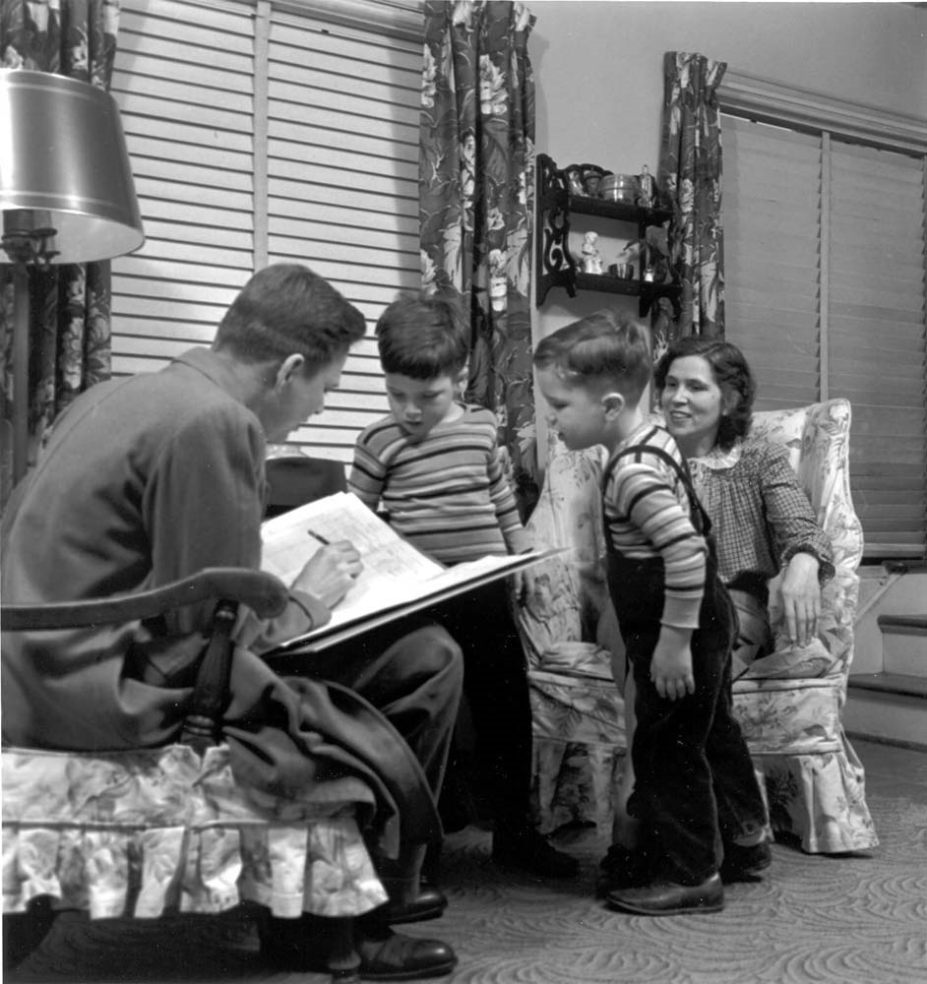
What is it?
Goal: Count everyone once—only once, and in the right place
In 2020, same goal as it’s always been – but this ain’t the 1950s!
US Census Bureau challenged to reduce costs in an increasingly complex world by taking advantage of modern technologies
Notes:
US Census Bureau has been challenged to reduce costs
As the largest peacetime mobilization in a exponentially growing population, the price of the census done the old fashion way is growing and growing
Census changing
Encourage the use of internet as the primary method of self-response
Automate systems
Updating the Master Address File
Automate in person enumeration
Automate enumerator training and administration of their tasks and payroll, etc.

Slide 4
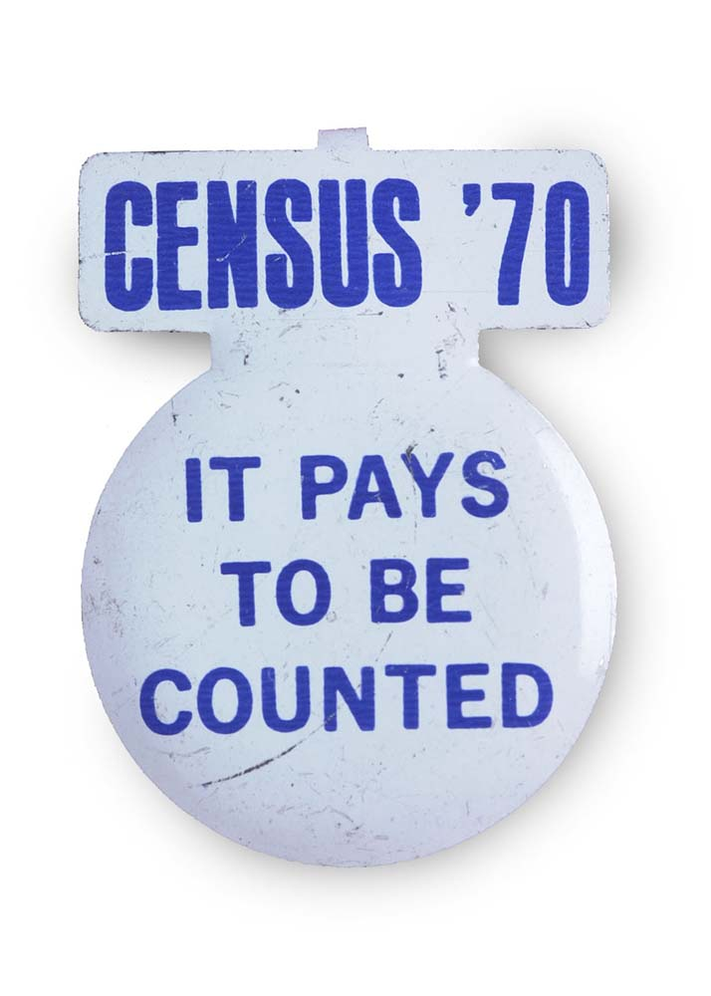
Why does it matter?
Purpose of Decennial Census
Article I, Section 2 of US Constitution & apportionment
Census-derived data influences
Federal, state, and local budget and planning
Business, developer, nonprofits
$16.7 billion in FY 2016 for Washington, or an average of $2,319 per person
Over 10 years, that’s $5.8 million for every 100 households missed!
Healthcare, Education, Highway and Rural assistance funding

Slide 5
2020 Census – High Level Facts to Know
Methods of Response
Internet, Phone, Mail
Five Mailings
Fewer Non-Response Visit/Admin. Records
Other Languages
Offices in WA State
Questionnaire
Notes:
Other Languages
= 12+1
Chinese
Vietnamese
Korean
Tagalog
Japanese
Hindi
Bengali
Thai
Gujarati
Khmer
Nepali
Urdu
Telugu
Burmese
Punjabi
Lao
Hmong
Tamil
Malayalam
Indonesian
Ilocano
Marathi
Sinhala
d another 46

Slide 6
2020 Census – High Level Facts to Know
Questionnaire – Some improvements
Short version
Ability to identify as bi- or multiracial
More options to define residents relationship to head of HH
Greater clarity to ensure children counted
Questionnaire – Some negatives
May include citizenship
Binary gender choice

Slide 7
Problem is…
Housing units not in the frame and/or people wanting to remain hidden
Hard to locate
Hard to contact
Hard to persuade
Hard to interview
Participation hindered by language barriers, low literacy, lack of internet access
Suspicious of government, low levels of civic engagement
Highly mobile, people experiencing homelessness, physical access barriers such as gated communities

Slide 8
Challenge: Hard-To-Count Populations
Young children
Highly mobile persons
Persons with complex living arrangements or crowded housing
Racial and ethnic minorities
Non-English speakers
Low income persons
Persons experiencing homelessness
Undocumented (and documented) immigrants
LGBTQ persons
Persons not living in traditional housing

Slide 9
Other 2020 Challenges
Less money = fewer tests and less robust field effort
Recruitment in a full employment economy
2020 Election Year

Slide 10
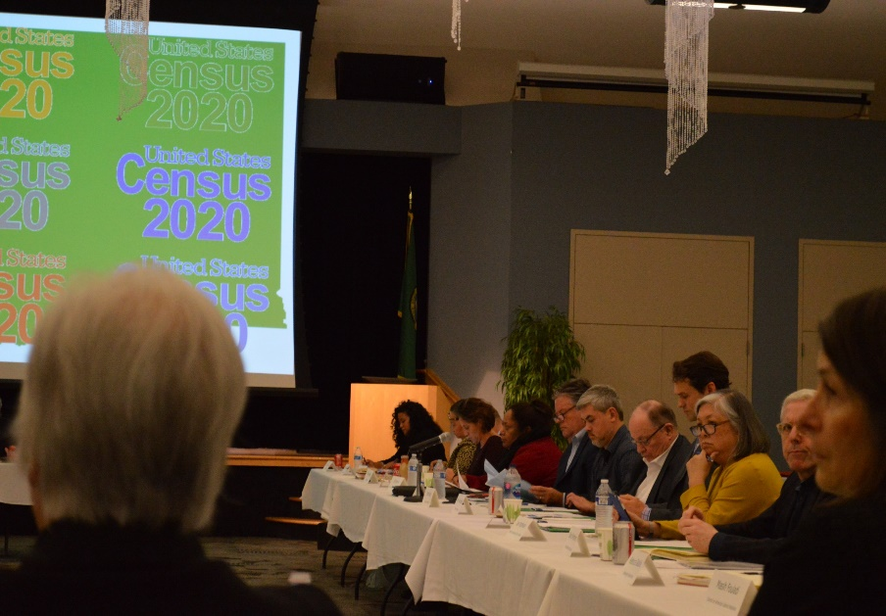
Overview
Complete Count Committee
Concept introduced with 1990 Census
Committee of volunteers established to increase awareness and motivate residents to respond to the census
Census ambassadors
Great enthusiasm so far in 2020
38 states
411 local

Slide 11
Complete Count Committee
THE CONCEPT
Mission/Vision: Ensure everyone is counted accurately
Leadership: High-level, highly visible, and spanning the spectrum
Function: Provide oversight of outreach – methods, message, and coverage
Grassroots movement of trusted messengers
Instilling trust and confidence in the process
Making it meaningful: Don’t count yourself out… get counted!
Assisting the process – explanations, FAQ, internet, language
Providing ‘intelligence:’ how the community is feeling/what it needs

Slide 12
State Agency CCC
State Agency Complete Count Committee
Established in early November
Internal education
Cataloguing state resources
Preparing work plans, official messaging & talking points
Ready to connect with other Complete Count Committees

Slide 13
State agencies reach everyone in WA
Websites
Social Media
Mailing lists
Newsletters
YouTube
Highway reader boards
Call centers
In-person program contact
Regional meetings
Conferences
Community outreach events
Translation services
Networks within communities
Kiosks in malls
Private sector interaction
Student messages to parents
Some agencies are “trusted partners”
State employees—108,000 FTEs
TVW (2020 Session)

Slide 14
What others are doing?
WA State Census Funding Partnership
WA Census Alliance
Counties and cities
Pierce County
King County and Seattle
Snohomish County
Ethnic/Linguistic Group
Functional

Slide 15
CASTING THE NET
75%
Target is:
Maximize self-response (mid-March to end of April)
Foster cooperation (New Construction, Group Quarters, SBE, NRFU)
Top-down education
New step
Bottom-up feedback
Bottom-up mobilization
1%
9%
15%

Slide 16
How to ensure Everyone Counts!
Deploy Structure to Mobilize & Encourage Participation
Train and Expand the Structure
Activate the Structure
Awakening & Set Up
Now-June 2019
Jun 2019-
Oct 2019
Nov 2019 -
March 2020
March-July 2020

Slide 17
What can you do?
Stay informed - www.ofm.wa.gov/2020census
Promote recruitment - https://2020census.gov/jobs
Contact your city or county officials and ask them when they plan to launch their Complete Count Committees and what you can do to help
Organize and spread awareness in your own professional and personal communities

Slide 18
What can CAPAA do?
Catalog the communities
Where are they located?
Are they hard to count? Why?
What messages would work for them?
Who are trusted messengers?
Positive messages
Ability to self identify and multi/bi-racial
Helps the community/your family

Slide 19
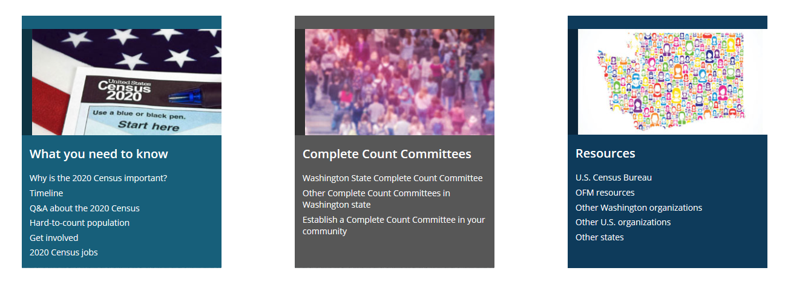
How can OFM help?
Keep you informed - www.ofm.wa.gov/2020census

Slide 20
How can OFM help?

Slide 21
CONCLUSION: ORGANIZE & UNLEASH A WAVE
Think in terms of a wave
Create awareness
Educate
Mobilize and organize resources
$$
Organizations
Research/Workplans
Recruitment
Hardware/venues
Unleash the promotion
April 1, 2020 Census Day
Post census day (non-response)

Slide 22
FOR MORE INFORMATION
Lisa McLean
Statewide Complete Count Coordinator
Email: lisa.mclean@ofm.wa.gov
Website: www.ofm.wa.gov/2020census

