Slide 1
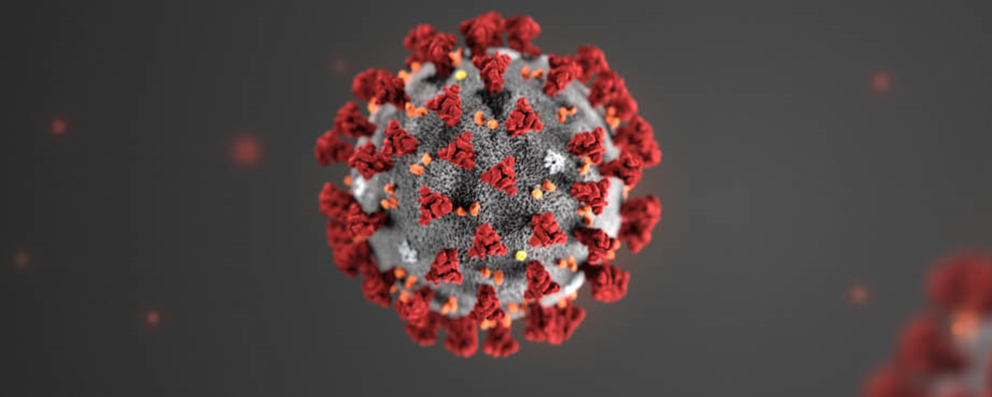
CAPAA Public Board Meeting
March 20, 2021

Slide 2
COVID Vaccine Program Updates
Mary Huynh

Slide 4
3 Week Forecast

Slide 5
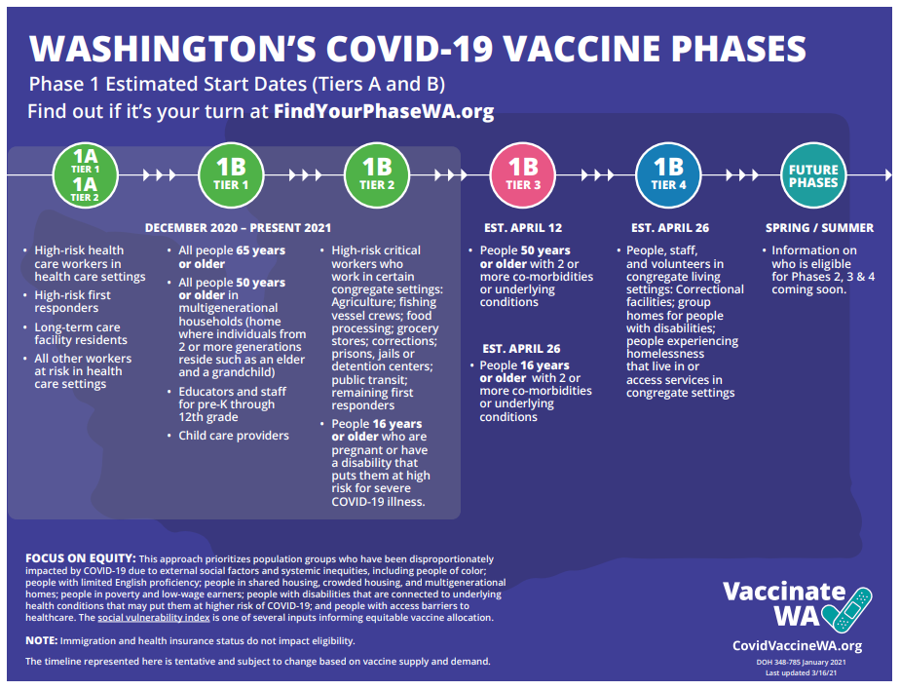
https://www.doh.wa.gov/Emergencies/COVID19/VaccineInformation/AllocationandPrioritization
https://medium.com/wagovernor/inslee-announces-extension-of-eviction-moratorium-expansion-of-vaccine-eligibility-long-term-635b34eb0ca

Slide 6
COVID-19 Vaccine Comparison
“A comparison of key details for each vaccine can be found below. This list is not exhaustive. For further details, see the FDA EUA document for Pfizer/BioNTech, Moderna, and Janssen. Note: head-to-head COVID-19 vaccine studies have not been conducted. Therefore, direct vaccine efficacy comparisons are not possible at this time.”
 | Pfizer/BioNTech vaccine | Moderna vaccine | Janssen vaccine
Target population | Approved for people aged 16 and older. | Approved for people aged 18 and older. | Approved for people aged 18 and older.
Vaccine efficacy | 95% effective at preventing symptomatic COVID-19 infection occurring at least seven days after administration of the second dose. Vaccine is 100% effective against hospitalizations and deaths from COVID-19. Efficacy rates did not vary based on demographic factors like age, race, or ethnicity. Insufficient data to determine if asymptomatic infection or infection transmission is prevented. | 94.1% effective at preventing symptomatic COVID-19 infection occurring at least 14 days after administration of the second dose. Vaccine is 89% effective against hospitalizations and 100% effective against deaths from COVID-19. No difference in efficacy based on race or ethnicity. Insufficient data to determine if asymptomatic infection or infection transmission is prevented. | 66.9% effective at preventing moderate to severe COVID-19 infection occurring at least 14 days after vaccine administration globally. 76.7% effective at preventing severe/critical COVID-19 infection occurring at least 14 days after vaccine administration in the United States. 85.4% effective at preventing severe/critical COVID-19 infection occurring at least 28 days after vaccine administration in the United States. Vaccine is 100% effective against hospitalizations and deaths from COVID-19. Vaccine efficacy was similar across both age groups (18- 59 and ≥60).
https://www.astho.org/COVID-19/Pfizer-Moderna-Vaccine-Comparison/

Slide 7
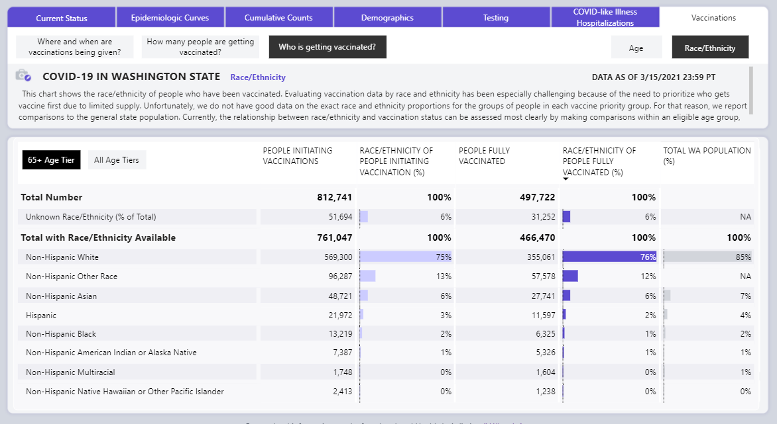
Data Dashboard – Race Ethnicity Data
https://www.doh.wa.gov/Emergencies/COVID19/DataDashboard

Slide 8
Website Changes
➲
Public-facing pages
➲
Provider-facing pages
Updates to in-language pages
Updated Frequently Asked Questions
Vaccine Collaborative page
Tile-based front page
Content separated into pages
New guidance section
Toolkit is easier to navigate
Coming soon: Information on new vaccine candidates
Notes:
I’m on the COVID-19 vaccine communications team and want to share with you some of the communication and health promotion projects we have going on right now and coming up.
First, the website..
Think of CovidVaccineWA.org as your all-in-one hub for the most up to date and reliable information about the COVID-19 vaccine in Washington. We are frequently updating the public facing page and recently did a major overhaul of the provider page. I’ll show you what that looks like in a second.
Provider guidance section includes content from the guidance emails we send out, such as following the 95% per week rule, what to do with the Pfizer 6th dose, and VIP scheduling.

Slide 9
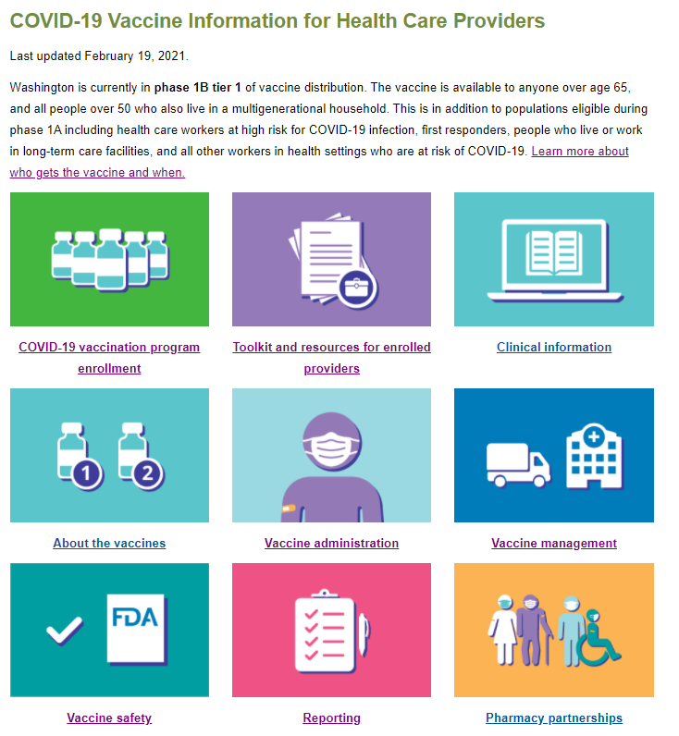
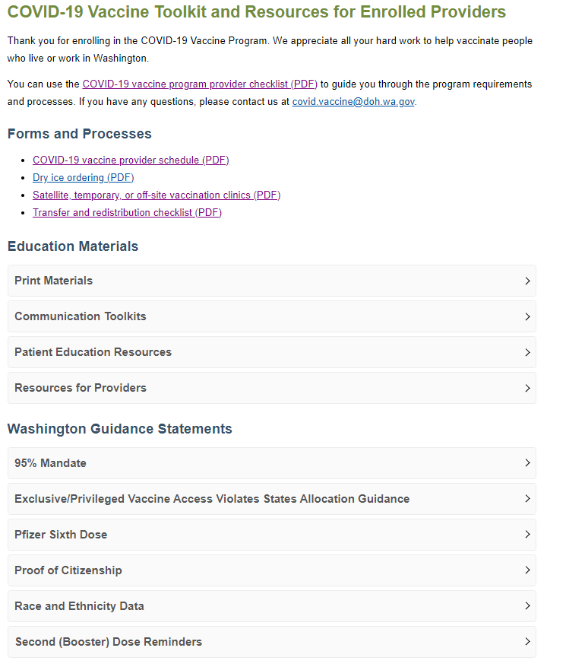
Notes:
Left image: new homepage
Right image: Toolkit and guidance page

Slide 10
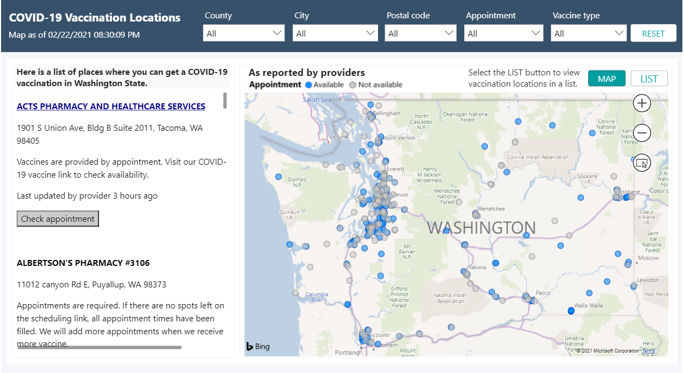
Vaccine Locator
Changes to Vaccine Locator
Easier-to-navigate map
Easier to see where vaccine is in stock*
Multiple languages
Updated daily
More coming soon!
* Current data are only as reliable as providers reporting in WA Health
Notes:
Buttons for Phase Finder and Vaccine Locator at top of:
www.CovidVaccineWA.org
www.doh.wa.gov
coronavirus.wa.gov
Select your language from the drop-down menu at the top of the locator.
You can still use the text list below the map

Slide 11
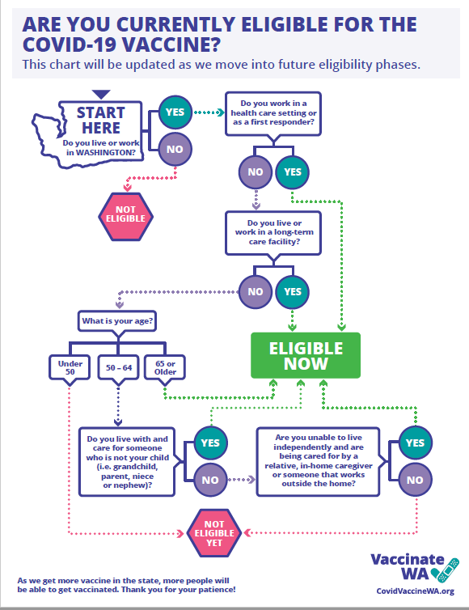
Phase Finder
Changes to Online Phase Finder
Now available in 10 languages
Coming soon: 20 more languages
New: Paper Version!
Providers: Please print to help anyone who has struggled with the online version
Found in partner toolkit: https://coronavirus.wa.gov/partner-toolkit/ covid-19-vaccine-phase-finder
Notes:
Found in provider toolkit at the partner toolkit under “Printable Phase Finder Tools.” Note the partner toolkit is different than the provider toolkit I showed earlier. Link above.
The paper version is two pages and the second page is an FAQ to help you understand the terms in the flow chart. I didn’t include an image of page two but you can check it out on the link on this slide.
Just for a quick update, so far we’ve had about a million and a half unique Phase Finder submissions!
(As of February 10, there were 1,424,255 including 5,891 to the Spanish language tool. )

Slide 12
Vaccinate WA Campaign: Current Activities
As of Feb. 15:
Campaign has delivered 175 million impressions, reaching 77% of the Washington population an average of 45 times.
Social media and Google Search campaigns have delivered 798,000 clicks to CovidVaccineWA.org, Coronavirus.wa.gov, and FindYourPhaseWA.org.
Feb. 15: Launched traditional and digital ads focused on Phase Finder. Online ads are in 28 languages that direct people to in-language Phase Finder.
Feb. 18: Hosted expert panel webinar, “Understanding WA’s COVID-19 Phases.” Over 2,750 people registered, and over 800 people attended.
Last week: DOH’s videos on How Vaccines Work in the Body and How Vaccines are Being Made were translated into 11 languages. Find them in the partner toolkit.
Continue to do audience research. A couple recent points:
Over 80% of respondents know if they are currently eligible for the vaccine.
80% of respondents say they do not plan to ask for a particular brand.
Notes:
The Vaccinate WA effort has three stages – Education, Intent and Action. Until now the broad campaign strategy focused primarily on education about vaccines and how to access them (Intent stage). This slide shows a few things we’re doing in these stages.
It’s almost time to launch the Action stage - celebrating progress so far, addressing barriers of “wait and see” and vaccine-hesitant audience segments. Next I’ll show you what’s coming.
Primary Objective: Motivate people living in Washington to get the COVID-19 vaccine when it is their turn.

Slide 13
Vaccinate WA Campaign: What’s Coming
Campaign Messaging Stages
Gratitude (March): Highlight stories of people helping others get the COVID-19 vaccine and thank them for their efforts to vaccinate our communities.
Success Stories (April-May): Highlight individuals and families who have received the vaccine and share their stories of why they chose to get vaccinated and how their experience went.
Trusted Messengers (June-onward): Feature trusted community voices to address specific priority audience barriers – those with either “wait and see” attitudes or hesitancy due to historical trauma around engaging with health care and public health systems.
Notes:
The Vaccinate WA effort has three stages – Education, Intent and Action. Until now the broad campaign strategy focused primarily on education about vaccines and how to access them (Intent stage).
It’s time to launch the Action stage - celebrating progress so far, addressing barriers of “wait and see” and vaccine-hesitant audience segments.
Primary Objective: Motivate people living in Washington to get the COVID-19 vaccine when it is their turn.
Next steps:
Campaign:
Distribute paper version of Phase Finder and post translated versions (will be available in 36 languages).
Promote February 25 Spanish expert panel on mental health with panelists representing the Latino community from Seattle Children’s Hospital and University of Washington.

Slide 14
Health Promotion and Communication Activities
Weekly newsletter: 40,000 subscribers, about 20-25% open rate
Regular provider guidance (email, website)
Blogs
Recent topics: Importance of second doses, vaccine safety, developing resilience
Upcoming topics: Expert panel follow-up, COVID-19 numbers (Spanish only)
Educational materials
One recent item: “Is it COVID-19 or a Vaccine Reaction?” visual (see next slide)
Toolkits
Translation
Culturally competent approaches
Template clinic signs (in provider toolkit). Signs are available in two sizes in English and Spanish.
Social media (see next slide)
Notes:
Recent items: Symptom guide, twice-weekly allocation graphics. See next slide
Guidance documents sent recently include weather delays, impact of timing of second dose, creating an emergency vaccine use plan
Coming up:
protest guide
employer guide
FAQs specifically on allocation
Finalize materials for partner toolkit, including safety and efficacy fact sheet, vaccine hesitancy discussion guide, and template messages.
Share guidance with providers on vaccine transportation requirements for off-site clinics.

Slide 15
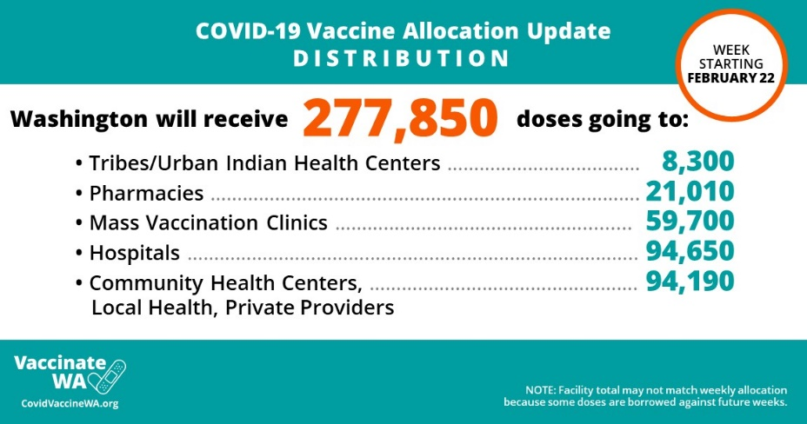
Recent items
Notes:
Left side is the symptoms graphic, available in PDF or image files
Right side are some things we’ve shared on social media recently. Twice-weekly allocation graphics plus an example of the vaccine confidence messaging from the Vaccinate WA campaign.

Slide 16
Equity & Engagement
Frances LimTIaco

Slide 17
DOH COVID-19 CURRENT VACCINE EQUITY STRATEGIES
Engage communities to inform vaccine prioritization and planning
Integrate a pro-equity approach into vaccine allocation and distribution
Prioritize allocation and support to providers who effectively serve disproportionately impacted communities
Invest in trusted community leaders, messengers and organizations
Ensure all communications, education and outreach efforts are culturally and linguistically appropriate and accessible
Strengthen the public health system’s ability to center communities in vaccine outreach and access
Foster opportunities for collaboration
Support a trauma-informed approach to vaccine conversations

Slide 18
Ensuring equitable access: Where to start
Use DOH’s COVID-19 Social Vulnerability Index (SVI) for planning.
Reserve appointments to be filled directly by trusted community partners.
Reserve appointments to be filled by phone only.
Collect race, ethnicity, and language data and ensure appropriate reporting through the IIS.
Provide alternative and accessible options for those to get their vaccine.
Ensure translated and culturally relevant materials are available on-site.
Set up telephonic interpretation services.
Be explicit in your statements that the vaccine is for everyone, including immigrants and any person living or working in Washington regardless of immigration status.

Slide 19
Pro-equity Strategies
Partnerships & Outreach
Addressing Access Barriers
Equitable Allocation
Communications & Outreach

Slide 20
New Vaccine Equity & Engagement Resources
Pro-equity strategies – rolled out Friday, March 12
Language Access Planning Tool.
Checklist to Ensure that Vaccine Sites are Accessible to People with Disabilities
Equitable Vaccine Site Placement Planning Tool
Other tools & resources available at: https://www.doh.wa.gov/Emergencies/COVID19/VaccineInformation/Engagement
Need technical assistance or support? Come to a provider drop-in space
March 16, 3:00 – 4:00 PM Click here to join the meeting +1 253-372-2181,,854319411# Phone Conference ID: 854 319 411#
March 19, 2:30-3:30 PM Click here to join the meeting +1 253-372-2181,,294387824# Phone Conference ID: 294 387 824#
March 24, 11:00 AM – 12:00 PM Click here to join the meeting +1 253-372-2181,,206909579# Phone Conference ID: 206 909 579#

Slide 21
Video remote ASL interpretation at mass vaccination sites

Slide 22
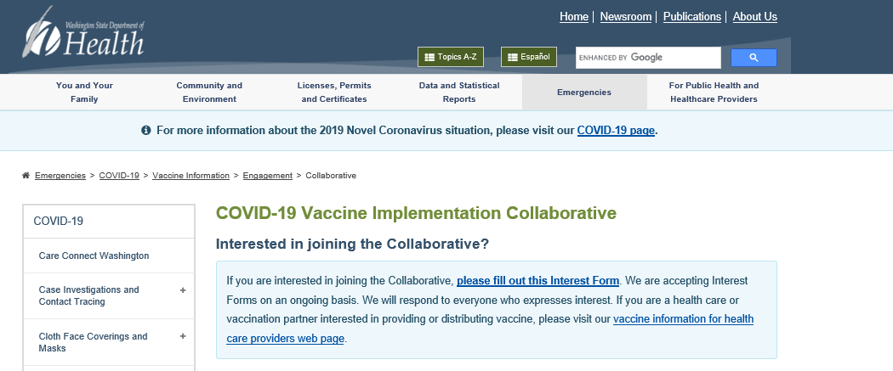
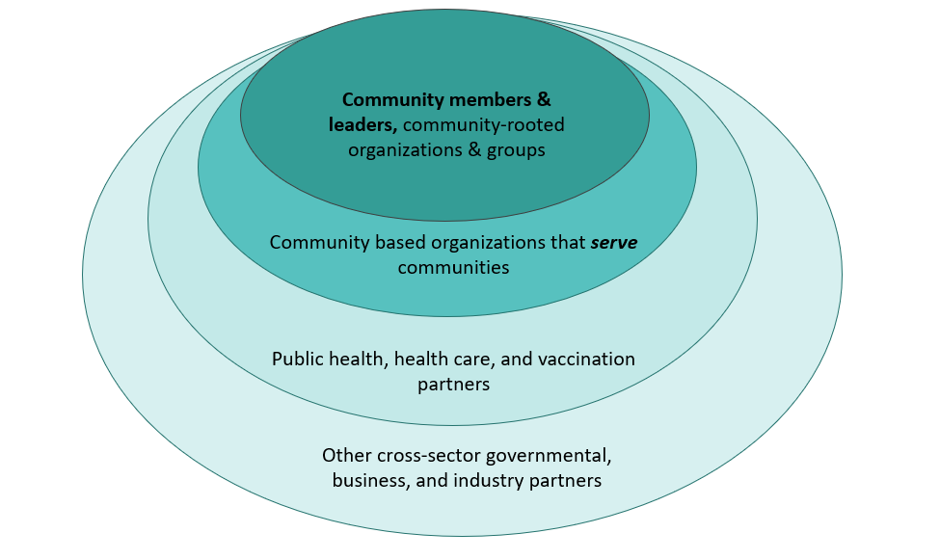
Vaccine Implementation Collaborative: Equitable Participation and Power Sharing
Collaborative: Washington State Department of Health

Slide 23
More information and resources available on DOH’S COVID-19 Vaccine Equity & Engagement Page: https://www.doh.wa.gov/Emergencies/COVID19/VaccineInformation/Engagement
Frances Limtiaco
Community Partnership and Engagement Manager
Community Relations and Equity Team
Frances.limtiaco@doh.wa.gov
564-999-1754 | www.doh.wa.gov

Slide 24
Questions?

Slide 26
Additional Resources

Slide 27
COVID-19 Vaccine Newsletter
The COVID-19 Vaccine Newsletter is a topic people can subscribe to on GovDelivery.
People can manage their subscriptions by going to the following link.
From there, click on ‘add subscriptions’ at the bottom of the page.
On the next page, expand the ‘Immunizations’ tab and check the box for “COVID-19 Vaccine Partner Newsletter.”

Slide 30
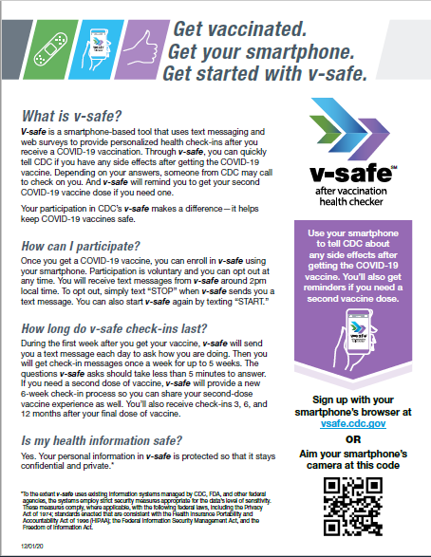

Slide 32
Federal Retail Pharmacy Partnership (FRPP) Federally Qualified Health Center (FQHC) Federal Program
FRPP:
Allocation remaining relatively steady for past 2 weeks
101,520 doses ordered for March 7 through March 12
Ordering data on prime vs. booster doses not available
FQHC:
HRSA steadily expanding to more FQHC and Community Health Centers
Allocation: 12,100 doses ordered and arriving this week for WA
56 facilities receiving vaccine this week via this program
Ordering data on prime vs. booster doses not available

Slide 33
JANSSEN (Johnson & Johnson) Vaccine

Slide 34
https://www.cdc.gov/vaccines/acip/meetings/downloads/slides-2021-02/28-03-01/02-COVID-Dooling.pdf

Slide 35
Source: Janssen Pharmaceuticals presentation, ACIP 02-28-2021; available https://www.cdc.gov/vaccines/acip/meetings/slides-2021-02-28-03-01.html. Accessed 02-28-2021.

Slide 36
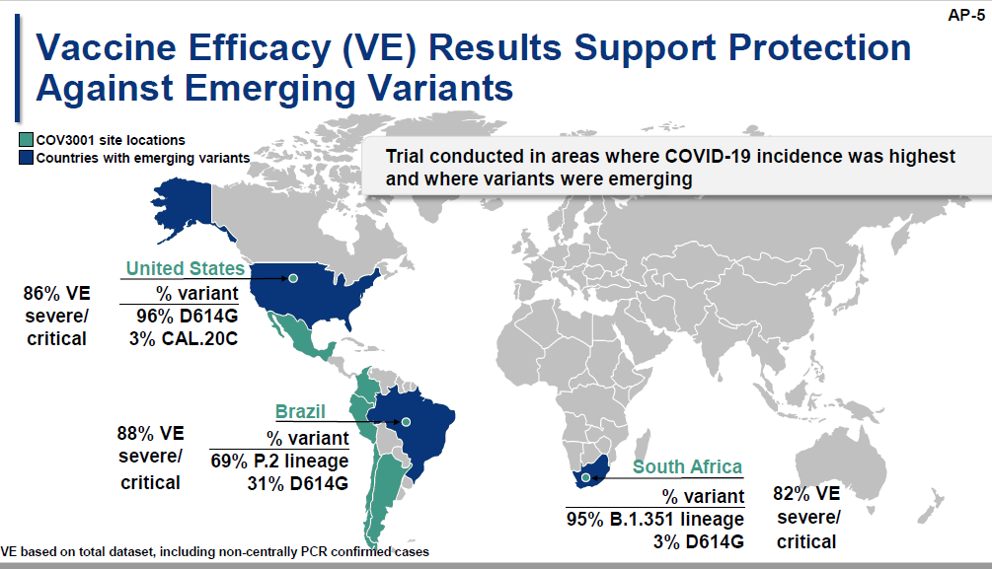
Source: Janssen Pharmaceuticals presentation, ACIP 02-28-2021; available https://www.cdc.gov/vaccines/acip/meetings/slides-2021-02-28-03-01.html. Accessed 02-28-2021.

Slide 37
Source: Janssen Pharmaceuticals presentation, ACIP 02-28-2021; available https://www.cdc.gov/vaccines/acip/meetings/slides-2021-02-28-03-01.html. Accessed 02-28-2021.

Slide 39
Source: Janssen Pharmaceuticals presentation, ACIP 02-28-2021; available https://www.cdc.gov/vaccines/acip/meetings/slides-2021-02-28-03-01.html. Accessed 02-28-2021.

Slide 40
Source: Janssen Pharmaceuticals presentation, ACIP 02-28-2021; available https://www.cdc.gov/vaccines/acip/meetings/slides-2021-02-28-03-01.html. Accessed 02-28-2021.

Slide 41
Source: Janssen Pharmaceuticals presentation, ACIP 02-28-2021; available https://www.cdc.gov/vaccines/acip/meetings/slides-2021-02-28-03-01.html. Accessed 02-28-2021.

Slide 42
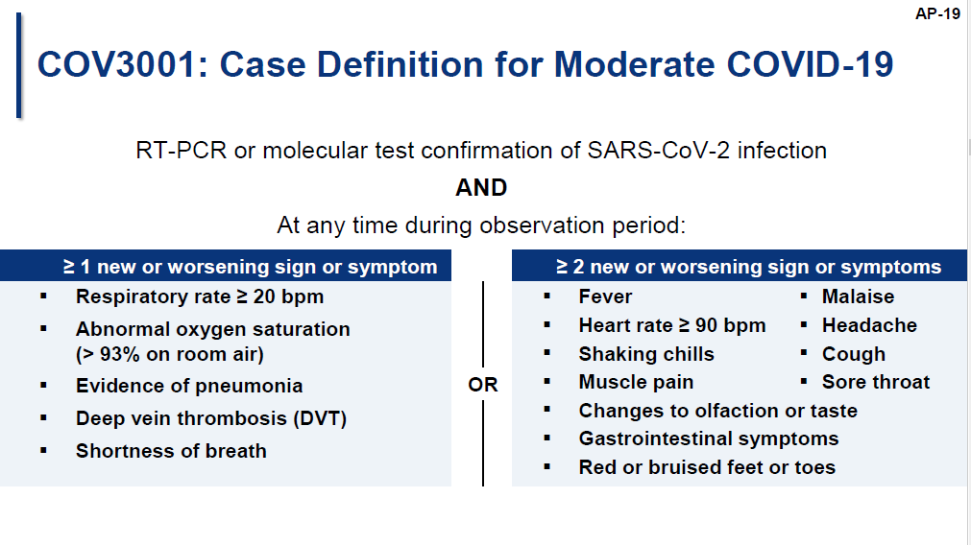
Source: Janssen Pharmaceuticals presentation, ACIP 02-28-2021; available https://www.cdc.gov/vaccines/acip/meetings/slides-2021-02-28-03-01.html. Accessed 02-28-2021.

Slide 43
Source: Janssen Pharmaceuticals presentation, ACIP 02-28-2021; available https://www.cdc.gov/vaccines/acip/meetings/slides-2021-02-28-03-01.html. Accessed 02-28-2021.

Slide 44
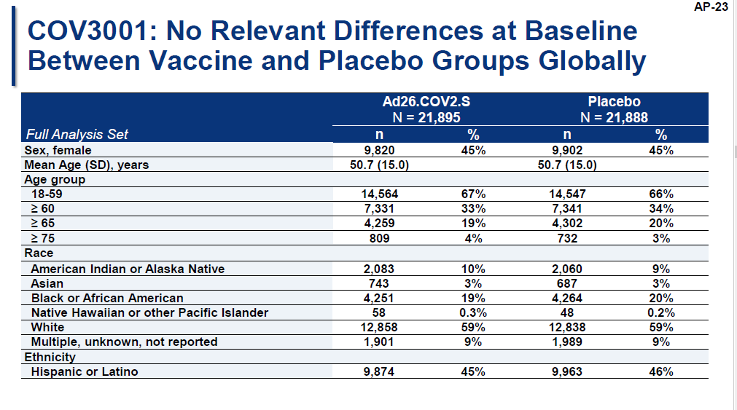
Source: Janssen Pharmaceuticals presentation, ACIP 02-28-2021; available https://www.cdc.gov/vaccines/acip/meetings/slides-2021-02-28-03-01.html. Accessed 02-28-2021.

Slide 45
Source: Janssen Pharmaceuticals presentation, ACIP 02-28-2021; available https://www.cdc.gov/vaccines/acip/meetings/slides-2021-02-28-03-01.html. Accessed 02-28-2021.

Slide 46
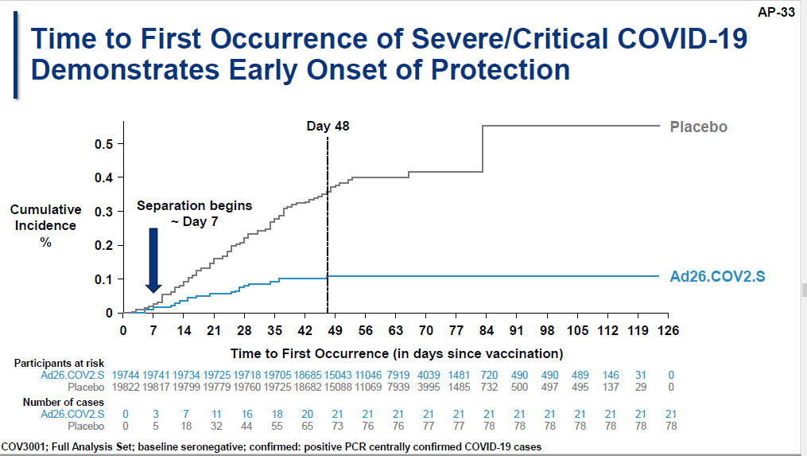
Source: Janssen Pharmaceuticals presentation, ACIP 02-28-2021; available https://www.cdc.gov/vaccines/acip/meetings/slides-2021-02-28-03-01.html. Accessed 02-28-2021.
Notes:
Global data >14 days >28 days
N=19,514 N=19544 (Placebo) N=19306 N=19178 (placebo)
Number of confirmed cases, n 116 348 66 193
VE (adjusted 95% CI) 66.9% 66.1%
U.S. data N=9119 N=9086 (placebo) N=8958 N=8835 (placebo)
51 196 32 112
VE (adjusted 95% CI) 74.4% 72%

Slide 47
Source: Janssen Pharmaceuticals presentation, ACIP 02-28-2021; available https://www.cdc.gov/vaccines/acip/meetings/slides-2021-02-28-03-01.html. Accessed 02-28-2021.

Slide 48
Source: Janssen Pharmaceuticals presentation, ACIP 02-28-2021; available https://www.cdc.gov/vaccines/acip/meetings/slides-2021-02-28-03-01.html. Accessed 02-28-2021.

Slide 49
Source: Janssen Pharmaceuticals presentation, ACIP 02-28-2021; available https://www.cdc.gov/vaccines/acip/meetings/slides-2021-02-28-03-01.html. Accessed 02-28-2021.

Slide 50
Source: Janssen Pharmaceuticals presentation, ACIP 02-28-2021; available https://www.cdc.gov/vaccines/acip/meetings/slides-2021-02-28-03-01.html. Accessed 02-28-2021.

Slide 51
Source: Janssen Pharmaceuticals presentation, ACIP 02-28-2021; available https://www.cdc.gov/vaccines/acip/meetings/slides-2021-02-28-03-01.html. Accessed 02-28-2021.

Slide 52
Source: Janssen Pharmaceuticals presentation, ACIP 02-28-2021; available https://www.cdc.gov/vaccines/acip/meetings/slides-2021-02-28-03-01.html. Accessed 02-28-2021.

Slide 53
Source: Janssen Pharmaceuticals presentation, ACIP 02-28-2021; available https://www.cdc.gov/vaccines/acip/meetings/slides-2021-02-28-03-01.html. Accessed 02-28-2021.

Slide 54
Source: Janssen Pharmaceuticals presentation, ACIP 02-28-2021; available https://www.cdc.gov/vaccines/acip/meetings/slides-2021-02-28-03-01.html. Accessed 02-28-2021.

Slide 55
Source: Janssen Pharmaceuticals presentation, ACIP 02-28-2021; available https://www.cdc.gov/vaccines/acip/meetings/slides-2021-02-28-03-01.html. Accessed 02-28-2021.

Slide 56
Source: Janssen Pharmaceuticals presentation, ACIP 02-28-2021; available https://www.cdc.gov/vaccines/acip/meetings/slides-2021-02-28-03-01.html. Accessed 02-28-2021.

Slide 57
Source: ACIP meeting 03-01-2021; available https://www.cdc.gov/vaccines/acip/meetings/downloads/slides-2021-02/28-03-01/02-COVID-Douoguih.pdf. Accessed 03-01-2021.

